Slide 1
SQL Project
Sales Performance Analysis of Walmart Stores Using Advanced MySQL Techniques

Slide 2
Business Problem
Walmart wants to optimize its sales strategies by analyzing historical transaction data across branches, customer types, payment methods, and product lines. To achieve this, advanced MySQL queries have been employed to answer challenging business questions related to sales performance, customer segmentation, and product trends.
The dataset contains detailed transaction data, including customer demographics, product lines, sales figures, and payment methods. This project used advanced SQL techniques to uncover actionable insights into sales performance, customer behavior, and operational efficiencies.
Dataset : Walmartsales.csv

Slide 3
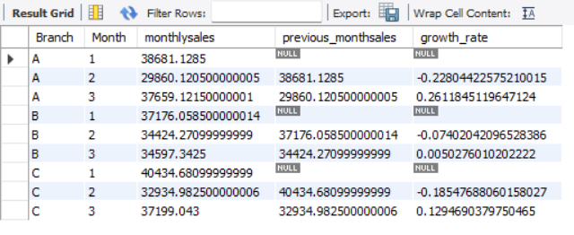
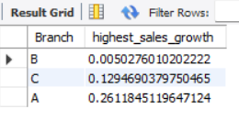
Task 1: Identifying the Top Branch by Sales Growth Rate
create view Growth_Rate as
select Branch, month(Date) as Month , sum(Total) as monthlysales ,
lag(sum(Total)) over (partition by Branch order by month(Date)) as previous_monthsales ,
( sum(Total) - lag(sum(Total)) over (partition by Branch order by month(Date)) ) /
lag(sum(Total)) over (partition by Branch order by month(Date))
as growth_rate from walmartsales
group by Branch , Month ;
select Branch , max(growth_rate) as highest_sales_growth
from Growth_Rate
group by Branch
order by highest_sales_growth ;

Slide 4
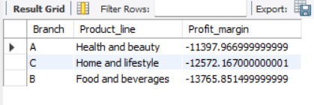
task 2 Finding the Most Profitable Product Line for Each Branch
with Profit_Calculation as (
select Branch, Product_line,
sum(gross_income) - sum(cogs) as Profit_margin
from walmartsales
group by Branch, Product_line )
select pc.Branch, pc.Product_line, pc.Profit_margin
from Profit_Calculation pc
join ( select Branch, max(Profit_margin) as Max_Profit
from Profit_Calculation
group by Branch) mp
on pc.Branch = mp.Branch and pc.Profit_margin = mp.Max_Profit;

Slide 5
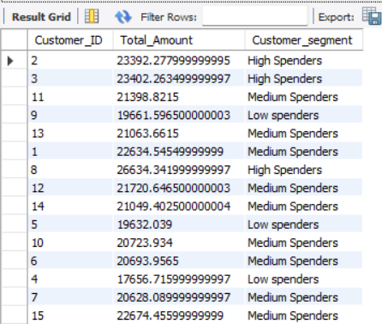
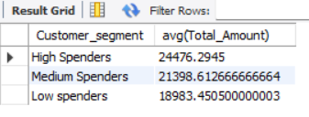
Task 3: Analyzing Customer Segmentation Based on Spending
create view spending_behaviour as
select Customer_ID , sum(Total) as Total_Amount
from walmartsales
group by Customer_ID;
create view customer_segment as
select Customer_ID, Total_Amount,
case
when Total_Amount > 23000 then "High Spenders“
when Total_Amount between 20000 and 23000 then "Medium Spenders"
else "Low spenders"
end as Customer_segment
from spending_behaviour;
select Customer_segment , avg(Total_Amount) from customer_segment
group by Customer_segment;

Slide 6
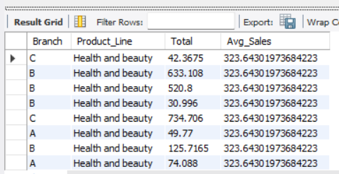
Task 4: Detecting Anomalies in Sales Transactions
with avg_sales as (
select Product_line, avg(Total) as Avg_Sales
from walmartsales
group by Product_line )
select w.Branch, w.Product_Line, w.Total, a.Avg_Salesfrom walmartsales w
join avg_sales a on w.Product_line = a.Product_line
where w.Total > 1.5 * a.Avg_Sales
or w.Total < 0.5 * a.Avg_Sales ;
Output : 569 row(s) returned

Slide 7
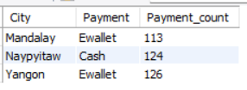
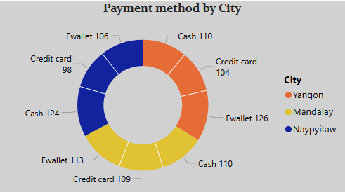
Task 5: Most Popular Payment Method by City.
with PPM as
(select City, Payment, count(Payment) as Payment_count
from walmartsales
group by city, payment)
select City, Payment, Payment_count
from(select City, Payment, Payment_count,
rank()over(partition by city
order by payment_count desc) as rnks
from PPM) tp2
where rnks = 1;

Slide 8
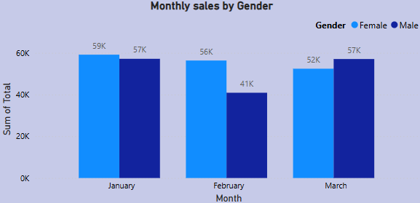
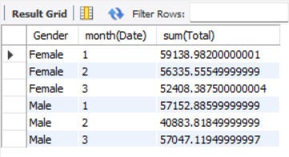
Task 6: Monthly Sales Distribution by Gender
select Gender, month(Date) , sum(Total)
from walmartsales
group by Gender, month(Date)
order by Gender;

Slide 9
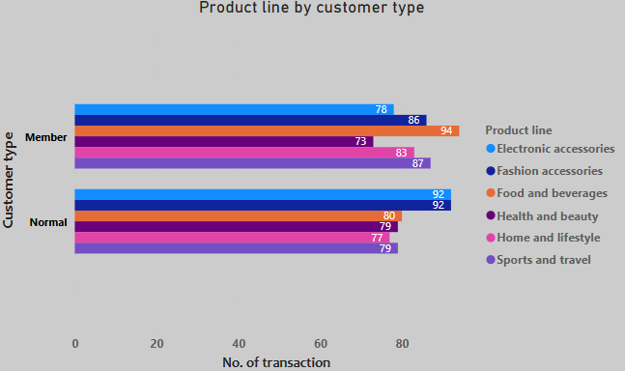
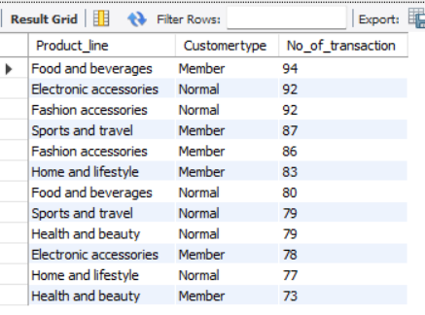
Task 7: Best Product Line by Customer Type.
select Product_line, Customertype, count(Product_line)as No_of_transaction
from walmartsales
group by Product_line, Customertype
order by No_of_transaction desc;

Slide 10
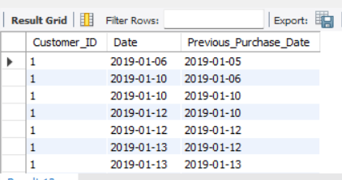
Task 8: Identifying Repeat Customers.
with purchases as (
select Customer_ID, Date,
lag(Date)
over( partition by Customer_ID order by Date)
as Previous_Purchase_Date
from walmartsales )
select Customer_ID, Date, Previous_Purchase_Date
from purchases
where datediff(Date, Previous_Purchase_Date) <= 30;
Output : 985 row(s) returned.

Slide 11
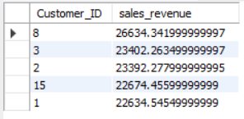
Task 9: Finding Top 5 Customers by Sales Volume.
select Customer_ID, sum(Total) as sales_revenue
from walmartsales
group by Customer_ID
order by sales_revenue desc
limit 5;

Slide 12
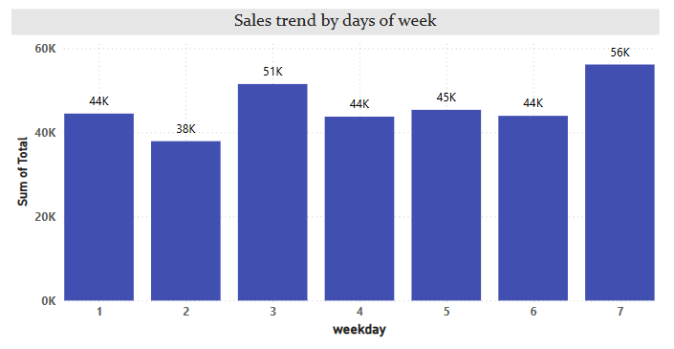
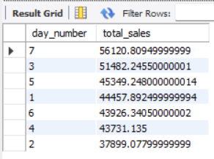
Task 10: Analyzing Sales Trends by Day of the Week.
select dayofweek(Date) as day_number, sum(Total) as total_sales
from walmartsales
group by day_number
order by total_sales desc ;

Slide 13
Key findings
Branch “B” had the growth rate 0.005 which exhibited the highest sales growth over time.
The “Health and Beauty” product line generated highest sales profit margin for Branch “A” , the “Home and Lifestyle” product line generated highest sales profit margin for branch “C” and the “Food and Beverages” product line generated highest profit margin in branch “B”.
Customers were segmented into 3 tiers – High , Medium and Low spenders based on the total sales amount.
High Spenders customer segment spends average 24476.2 of total sales amount, while Medium Spenders customer segment spends 21398.6 and Low Spenders customer segment spends 18983.4 of total sales amount.
Some transaction showed extreme sales values as compared to the average sales , indicating possible errors and fraud.
E-wallet and Cash were most preferred payment methods.
E-wallet payment method was ranked first in most popular payment method as 113 and 126 numbers of transaction were done in Mandalay and Yongon city. Cash payment method has 124 number of transaction which is also popular payment method in Naypyitaw city.

Slide 14
The monthly sales distribution shows that females contributed more to sales revenue compared to males in specific month.
Females generated 59138.8 , 56335.5 and 52408.3 sales revenue while males generated 57152.8 , 40883.8 and 57047.1 sales revenue over the months. It indicates that the sales revenue from female customers was decreasing over the time.
The “Food and Beverages” product line was preferred by Member customer type whereas “Electronic Accessories” and “Fashion Accessories” were favoured by Normal customers.
A significant percentage (i.e. 98.5 %) of customers made repeat purchases within 30 days , indicating strong customer loyalty behaviour.
Customers with IDs 8,3,2,15 and 1 were the top 5 customers who contributed large portion of total revenue, highlighting the importance of high value customers.
Day 7 recorded the highest sales with 56120 while Day 2 had lowest sales of 37899 of the week.

Slide 15
Business insights
Focus on Branch “B” for expansion and investments.
Promote product line “Health and Beauty” , “Home and Lifestyle” and “Food and Beverages” ensuring competitive prices.
Implement loyalty programs for High spending customer segment to boost retention.
Investigate anomalies in transactions to prevent errors, fraud and revenue leakage.
Promote E-wallet and Cash payment method to make checkout smoother.
Improve marketing strategies for males as they generate fewer revenue as compare to female and also engage females by giving offers in relative products.
Run promotional campaigns on High sales days (weekend day) to maximize revenue.
Analyse seasonal trends to improve forecasting and sales planning.

Slide 16
Recommendation
Expand operations in high growth branches.
Focus on profitable product lines for promotions.
Implement targeted discounts for high and medium spenders.
Investigate and address anomalies in sales transaction.
Motivate customers to use preferred payment option.
Boost customer participation in reward programs.
Promote discounts and offering based on high sales days.

Slide 17
Explanation video link
https://drive.google.com/file/d/1qrwd5OKt_TNcgUqeGOMtkfNSNlNuOIwS/view?usp=sharing
Presented by : Kavya Chakradhari

Slide 18
Thank you !

